Slide 1
Gyg
Shawn Mitchell
Isuru Nanayakkara
Jonathan Luetze
J. Anthony Timberlake
Andrew Vivian

Slide 2
Outline
Overall Description
Functional Requirements
Nonfunctional Requirements
Diagrams
Timeline

Slide 3
Overall Description
Gyg makes it easy to:
Find simple jobs to do in your area.
Post new jobs that you need help with.
Establish a trustworthy medium for getting tasks done.
As opposed to sketchy non-community based applications.

Slide 4



How it works
ACTION 1: FIND GYGS
Find Gygs that they want to do for someone else
Filter by User and/or Area
Post a Gyg that they want someone else to do for them
View Gygs
Past and upcoming to do’s
Posted Gygs

Slide 5



How it works
ACTION 2: COMPLETE GYGS
User selects a Gyg that they want to do
Both users scan a QR code to start and finish a Gyg
User that was helped can comment on the user who worked

Slide 6
How it works
ACTION 3 : VIEW PROFILE
Name
Picture
General Working Area
Skillset
Description
View past transactions

Slide 7
Front End and Back End Expectations
Front End
Material Design guidelines
User friendly layout
Simple UI
Back End
Firebase - Database storage and transaction records.
Node.js - For data crunching and networking
Paypal / Plaid APIs for financial processing.

Slide 8
Nonfunctional Requirements
Map using Google Maps API
QR Scanner
Scalability
Filtering system based on jobs
Usability

Slide 9
Functional Requirements
Focus: Find or perform small side jobs easily.
Reliable and Fair: App will have features to ensure job completion.
Outsourcing: Have external API’s deal with financial operations.
Server:
Must account for delays.
Schedule tasks with appropriate priority.

Slide 10
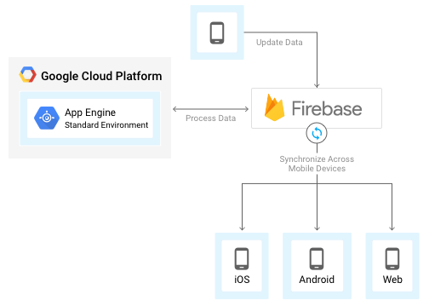
App Engine + Firebase
Firebase will be the database where all data will be stored.
App Engine will be listening to Firebase data and process accordingly.
App Engine will be using Node.js.

Slide 11
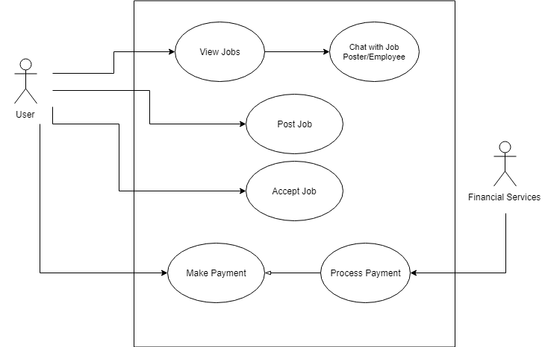
Use Cases

Slide 12
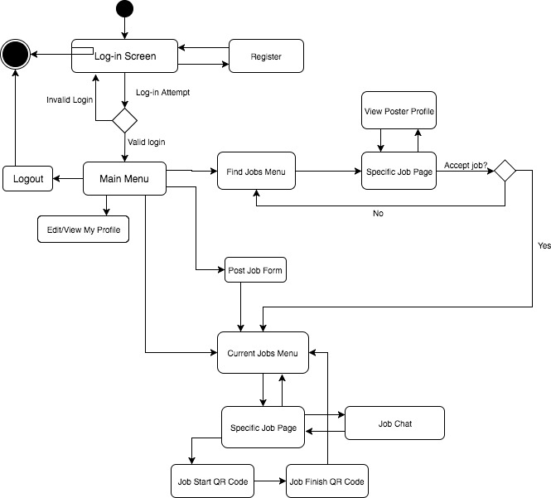
Activity Diagram

Slide 13
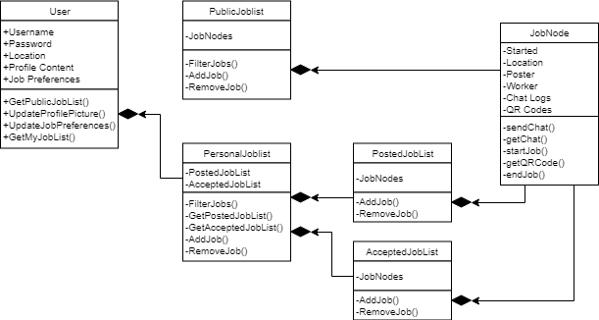
Class Diagram

Slide 14
Risks
The back-end can get messy if not structured properly.
Financial transactions need to be carefully and securely implemented.
Direct interactions between users cannot be controlled. Cannot guarantee safety.

Slide 15
Possible Future Features
Assignment 1
Bid Style Interactions
Assignment 2
Social media integration
Assignment 3
Recommended gygs

Slide 16
Begin to connect the Front end with the backend.
Optimize synchronization.
Begin setting up Front End and Back-End skeleton.
Delivery
03.04.18
03.20.18
03.30.18
04.15.18
04.30.18
FE: Design Layouts, Navigation
BE: Design a RESTful connection protocol.
Refine the UI and performance as best as possible.
Extensive testing

